Slide 1

Problem Solving Using Computer
Course Code: BCAC 0018
Lecture – 10 & 11
Course: BCA I Year I Semester
By: Mr. Sanjiv Agrawal
Sanjiv.agrawal@gla.ac.in
+91-8923015116

Slide 2
Concept of Problem Solving
A general process of problem solving involves the following steps:
Understanding the problem and describing the problem in a clear, complete and error free from
Designing an algorithm
Developing a computer solution
Testing the solution
Documentation
Maintenance

Slide 3
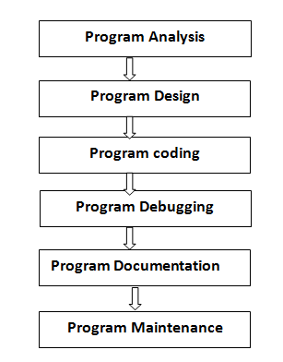
Steps of Problem Solving

Slide 4
1. Program Analysis:
Analyze the problem and what desire output you want.
Analysis and gathering knowledge about the requirement from problem.
Try to identify what requirement you need as a solution.
Clearly define what the program is to do.
Clearly define the processing tasks.

Slide 5
2. Program Design:
In designing phase, we designed the proposed solution without writing a computer program by using the techniques:
Flow Chart
Algorithm
Pseudo code
3. Program Coding:
It is the process of transforming design (flow chart, algorithm, pseudo code) in a computer program by using any programming language.
The out put of program must be the solution of intended problem.

Slide 6
4. Program Debugging:
Bug means “Error” and debugging means correct the error.
In this step developer test the program and try to find out any error and if error occurs then fix it.
After testing program to ensure that all modules working correctly or not.

Slide 7
5. Program Documentation:
For a programmer it is easy to understand program and code but general user cannot understand programming code and program working how to operate so it’s a responsibility of developer to create a program with some documentation.
The program documentation involves :
  Problem Definition
  Problem Design
  Documentation of test perform
  History of program development
  User’s manual: A user’s manual is used by a user to know about a program’s input, processing, and output data.

Slide 8
6. Program Maintenance:
Once a program has been formed, to ensure its longevity, maintenance is a must. It is used to correct and upgrade program. The maintenance of a program involves the following :
Detection and Elimination of undetected errors in the existing program.
Modification of current program to enhance its performance and adaptability.
Enriching the program with new capabilities.

Slide 9
Problem Definition/Specification:
A computer program is basically a machine language solution to a real-life problem. In order to solve the problem, it is very necessary to define the problem to get its proper understanding.
For example, suppose we are asked to write a code for “ Compute the average of three numbers”. In this case, a proper definition of the problem will include questions like:
“What exactly does average mean?”
“How to calculate the average?”

Slide 10
Once, questions like these are raised, it helps to create the solution of the problem in a better way.
It should definitely include :
INPUT :
What is the input set of the program?
OUTPUT :
What is the desired output of the program and in what form the output is desired?

Slide 11
Program Design:
Program design consists of the steps a programmer should do before they start coding the program in a specific language. These steps when properly documented will make the completed program understandable for other programmers to maintain in the future.
There are three broad areas of activity:
Understanding the Program
Using Design Tools to Create a Model
Develop Test Data

